Slide 1

Prepared by Logical Operators
for COSC 3F00
February 6th, 2014

Slide 2
Team Introductions

Slide 3
Using Agile Principles
Our highest priority is to satisfy the customer through early and continuous delivery of valuable software
Working software is the primary measure of progress
At regular intervals the team reflects on how to become more effective then tunes and adjusts its behavior accordingly

Slide 4
Communication
reviewed the rules and game play of chinese checkers
brainstormed and built a list of high level use cases

Slide 5
Feature Set | Description | Order | Target Iteration
Game | create a game | 1 | 1
Game | specify game settings (# of players, player color) | 2 | 1
Game | show hotseat game board | 3 | 1
Game | peg animation | 4 | 2
Game | hotseat (offline, no AI) | 5 | 2
Game | close game | 6 | 2
Account | acheivements
Account | anonymous accounts
Account | create an account
Account | edit/delete account

Slide 6
Feature Set | Description | Order | Target Iteration
Account | friends list
Account | game history, rank, etc.
Account | leaderboards/ranking
Account | login with Facebook
Account | logout
Account | message inbox
Account | password reset (via android ... if poss.)
Account | profile page
Admin | admin screen for system analytics
Admin | EULA + COPPA compliance

Slide 7
Feature Set | Description | Order | Target Iteration
Game | 1st-6th place get points
Game | AI takes over when user forfeit
Game | demo mode (to watch AI)
Game | friend request
Game | game playback
Game | in-game chat
Game | multiple games
Game | pegs left to win
Game | play against an AI
Game | player label
Game | set music/fx volume

Slide 8
Feature Set | Description | Order | Target Iteration
Game | timed games
Game | timeless (long) games
Game | toggle show possible moves
Game | turn notification
Help | "help" section
Web | app webpage
 | game lobby

Slide 9
Planning
Total budget in hours
Split budget into time-boxed iterations
Prioritized list of use cases
Pulled highest priority use cases into first iteration

Slide 10
Team Capacity Calculations
Release Level Plan |  |  | Iteration Level Plan
Start | 9-Jan |  | Iteration # | # Weeks | Hours
Finish | 27-Mar |  | 1st iteration | 4 | 192
Last Day of Class | 4-Apr |  | 2nd iteration | 3 | 144
 |  |  | 3rd iteration | 3 | 144
Work Days | 77 |  | 4th iteration | 1 | 48
Work Weeks | 11
# of People | 8 |  | Total Hours |  | 528
Hours/Week/Person | 6
Total Hours | 528

Slide 11
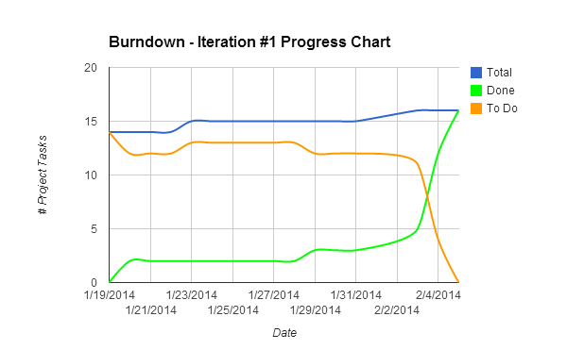

Slide 12
Design
Use Cases
User Interface mockups
Data Flow and UML
Test plan

Slide 13



Tools
Google Drive
GitHub (https://github.com/kubasub/chinese-checkers)
Android Studio (http://developer.android.com/sdk/installing/studio.html)
SourceTree (http://www.sourcetreeapp.com)
Pen and paper

Slide 14
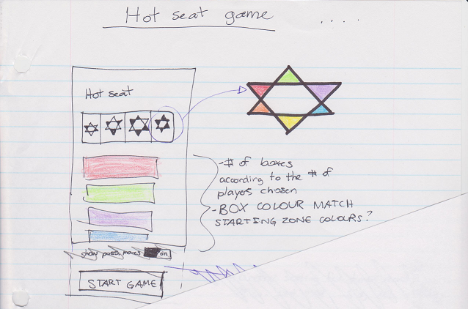

Slide 15
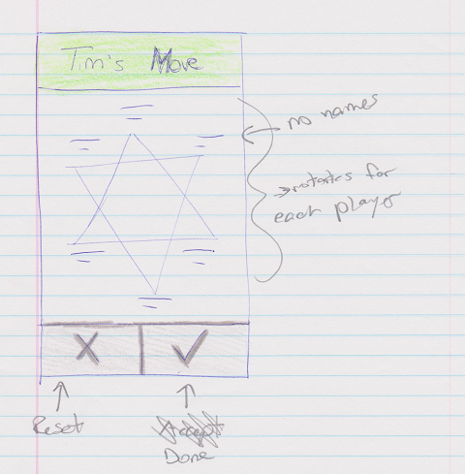

Slide 16
Construction
code and unit test
integration test
performance test
stress test
usability test
acceptance test

Slide 17
Retrospective
Some notes from our retrospective

